Slide 1
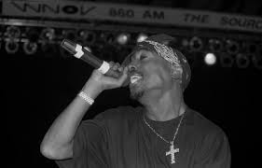
Gangster Rap

Slide 2
Lesson 1

Slide 3
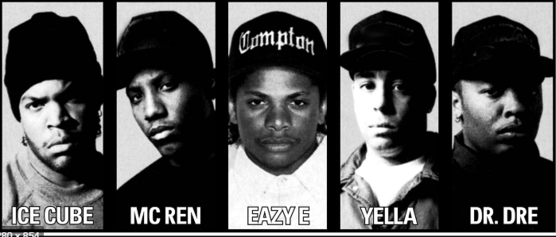
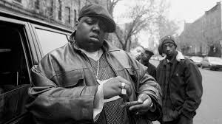
History of Gangster Rap
The rappers who popularized Gangster rap
Gangster or ‘Gangsta’ rap is a branch of rap emphasize a ‘Thug-life’ lifestyle. The genre became popularized in the 1980’s by the West Coast. People like the now famous actor Ice Cube was an important influencer of this genre. He and other rappers formed a band which became very influential because they made songs about how they were abused by police in their childhood. Eventually, many more rappers became famous adopting the ‘Gangsta Rap’ style such as Tupac Shakur.
Later, East Coast adopted the Gangsta Rap and there became a rivalry between West and East Coast. The Wu-tang Clan emerged after Ice cube and his band disbanded however people were considering have Wu-Tang as their favorite. However East Coast gansgta rap was different to West Coast because they focused on more philosophical lyrics rather than rapping about their problems with gruesome lyrics. Eventually, East Coast rappers overtook West Coast in popularity. The face of this was Notorious B.I.G, he played a big role in the rivalry and is considered one of the best rappers in history.

Slide 4
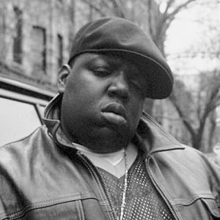
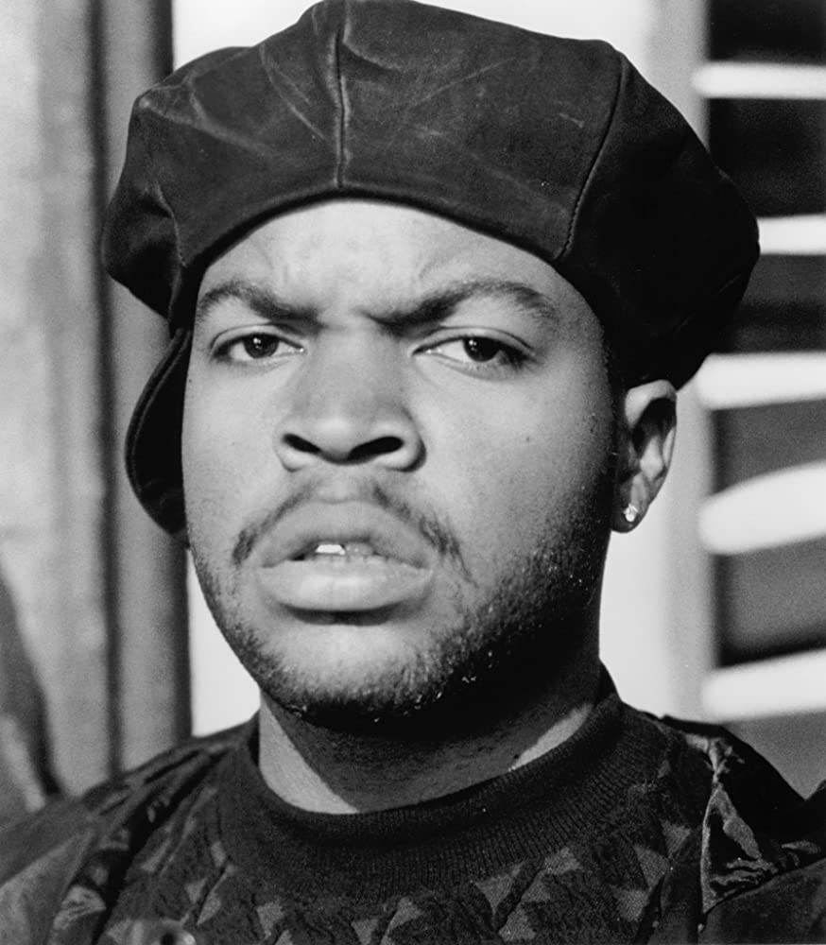
Lesson 2
The Artist

Slide 5
Notorious B.I.G
Songs listened to:
Big Poppa:
https://www.youtube.com/watch?v=qz4ZsDo9kTc
Juicy:
https://www.youtube.com/watch?v=wb5KEO9z_kc
Unbelievable:
https://www.youtube.com/watch?v=Y4najWe1ZBg
Christopher George Wallace was a rapper from New York. He was considered the best from the East coast. With a lyrical delivery laidback and yet slick, belying the lyrics' often grim content and his own intimidating appearance, his songs were often semi-autobiographical, telling of hardship and criminality, but also of debauchery and celebration.
His debut album was Ready to Die (1994). Songs like ‘Juicy’ and ‘Big Poppa’ were the hits of this album. Shortly after, he led a protegee group called JUNIOR M.A.F.I.A. and became friends with Tupac Shakur.
In 1995, Wallace's protégé group, Junior M.A.F.I.A. ("Junior Aces At Finding Shrewdly States of mind"), discharged their make a big appearance collection Scheme. The bunch comprised of his companions from childhood and included rappers such as Lil' Kim and Lil' Desist, who went on to have solo careers. The record went Gold and its singles, "Player's Song of devotion" and "Get Cash", both including Wallace, went Gold and Platinum.
Wallace got to be included in a contention between the East and West Coast hip jump scenes with Shakur, now his previous companion. In an meet with Vibe in April 1995, whereas serving time in Clinton Restorative Office, Shakur blamed Uptown Records' originator Andre Harrell, Sean Combs, and Wallace of having earlier information of a theft that come about in him being shot five times and losing thousands of dollars worth of adornments on the night of November 30, 1994.
Wallace started recording his moment studio collection in September 1995 over 18 months in Modern York City, Trinidad, and Los Angeles. The recording was hindered by harm, lawful debate, and a profoundly publicized hip bounce dispute. Amid this time, Wallace moreover worked with pop artist Michael Jackson on the collection History. Lil' Terminate afterward claimed that whereas Wallace met Jackson, he was constrained to remain behind, with Wallace citing that he did not "believe Michael with kids".
In June 1996, Shakur released "Hit 'Em Up", a diss track in which he claimed to have been intimate with Faith Evans, who was offended from Wallace at the time, which Wallace had replicated his fashion and picture.
In February 1997, Wallace traveled to California to promote Life After Death and record a music video for its lead single, "Hypnotize". He was driving home from a party when a car pulled up and shot him 4 times. At age 24, Christopher Wallace was pronounced dead at 1 am.

Slide 6
Ice Cube
Songs Listened To:
Express yourself:
https://www.youtube.com/watch?v=u31FO_4d9TY
Amerikka’s most Wanted:
https://www.youtube.com/watch?v=prirvhXCx8w
You know how we do it:
https://www.youtube.com/watch?v=vLIFQ5d8cVo
O’Shea Jackson was born In 1969. He is an American rapper, writer, actor that goes by the name of Ice Cube. Ice Cube at first picked up acknowledgment in 1986 as a part of the hip hop gather N.W.A., which picked up commercial success earlier to disbanding around the time N.W.A formed.
Ice cube, nearby Dr. Dre and Eazy E, formed the group N.W.A, where he picked up extraordinary reputation as the group's essential lyricist and entertainer, famous for getting to be one of the founders of gangsta rap, and pushing the boundaries of expressive lyrics and music videos in well known music. They would be joined by DJ Yella and MC Ren.
After leaving N.W.A in December 1989, Ice Cube embarked on a successful solo career, releasing the albums AmeriKKKa's Most Wanted (1990) and Death Certificate (1991), both of which have attained platinum certification in the United States, while also being classed as defining albums of the 1990s. Much of his musical output has contained harsh socio-political commentary and storytelling, which has earned him several accolades from multiple publications and artists, often cited as an influence and one of the best rappers of all time.
Ice Cube would later transition into the film industry where who would start in Boyz in da hood (his debut), he would write Friday and Straight outta Compton, he would star in comedic films such as ride along.
In 1996, Ice Cube shaped Westside Connection with Mack 10 and WC, and together they released an collection called Bow Down. A few of the collection was utilized to engage within the East Coast–West Coast hip hop competition of the 1990s. The album's eponymous single come to number 21 on the singles charts, and the collection itself was certified Platinum by the conclusion of 1996. With Bow Down, Westside Connection brought their possess plan to the hip jump scene. Ice Cube, Mack 10 and WC had developed tired of being ignored by most East Coast media outlets; the collection was outlined to inject a sense of pride in West Coast hip bounce fans and to begin a bigger development that a few individuals who felt underappreciated might recognize with.

Slide 7
Lesson 3

Slide 8
Notorious B.I.G Top 20 songs
The What
Get Money
One More Chance – Remix
Notorious Thugs
Live at MSG Freestyle
Dead Wrong
Things Done Changed
Suicidal Thoughts
Hypnotize
I Got a Story to Tell
Flava in Ya Ear – Remix
Kick in the Door
What's Beef?
The 10 Crack Commandments
Sky's the Limit
Who Shot Ya
Warning
Juicy

Slide 9
Notorious B.I.G fact file
Christopher Wallace, a.k.a. Biggie Smalls, was born on May 21, 1972 in Brooklyn, Modern York. He was the child of Jamaican parents, Voletta Wallace, a pre-school instructor, and George Latore, a welder and small-time politician.
Not greatly alluring, Wallace named himself Biggie, for his weight. Biggie was a Dark man who was overweight, amazingly dark skinned, and had a hooligan in his eye, however he was a charmer. A youthful producer and at some point producer by the title of Sean Combs listened Biggie's early tapes. Inspired, Puffy went to sign Biggie to his new label, Bad Boy Records.
Puffy and Biggie worked on the artist's to begin with album. Biggie was to begin with being on a remix of a Mary J. Blige tune and a track on the Who's the Man? (1991) soundtrack. After these triumphs, the album worked on prior went through its last touches and was released in 1994, titled "Ready to Die." The record was certified platinum rapidly, and the Notorious B.I.G. was named MC of the Year at the 1995 Billboard Music Awards. Shortly after that, he met a west coast rapper named Tupac Shakur.
Tupac backed Biggie and was frequently giving him counsel. In any case, their friendship turned into the foremost violent period of hip-hop music on November 30, 1994. While Biggie and Puffy were at a recording session at Quad Recording Studios in Manhattan, Tupac went there to record with another rapper for his third studio album, "Me Against The World" at the same time, but within the lobby, Tupac was held at gunpoint and ransacked of $40,000 worth of gems. Tupac was shot five times. Biggie surged down fair in time to see Tupac being stacked into an emergency vehicle. Expanding a center finger, Pac faulted Biggie for the shooting and said that Biggie knew approximately it and fizzled to caution him. This started the East Coast, West Coast rivalry. Tupac afterward recovered from his wounds.
Afterward, The whole nation got to be divided into two groups, the west side and the east side, which got to be Death Row Records versus Bad Boy Records, Marion 'Suge' Knight versus Puff Daddy, and Tupac versus Biggie. The two of them at long last met once more late in 1995, and Tupac subtly said to Biggie, "I'm just tryin' to sell a few records." Shockingly, it got to be exceptionally real when on September 7, 1996, Tupac was shot four times in a drive-by shooting off the Las Vegas strip after he cleared out a battle he was included in interior of the MGM Amazing Inn after a Mike Tyson boxing coordinate. He died six days afterward.
Biggie went to the west coast for a few occasions, to back for his following release album, "Life After Death," but also to form a statement that the rivalry was over. On Walk 7, 1997, he gone to the Soul Train Music Grants and went to the after party facilitated by Vibe magazine and Qwest Records on Walk 8. On Walk 9, Biggie was sitting in an SUV on the road when he was shot numerous times by an obscure attacker. He died nearly right away. Hip-Hop faced its most prominent catastrophe when both Tupac Shakur and The Notorious B.I.G. were murdered. Biggie was as it were 24 years old.

Slide 10
Eazy E Top 20 songs
Boyz-N-the-Hood
It's On
Eazy-Duz-It
Only If You Want It
Straight Outta Compton
Er Said Than Dunn
Down 2 Tha Last Roach
No More?’s
We Want Eazy
2 Hard Mutha’s
Sorry Louie
Nobody Move
Switchez - Impact of a Legend
Wut Would You Do
How We Do (Remix)
Radio
Tumblr Girls
Cruisin Down the Street In My 64
Any Last Werdz
Sippin' On a 40

Slide 11
Eazy E fact file
Eazy-E was an American Rapper who is referred to as The Godfather of Gagsta rap. He was born Eric Lynn Wright on September 7th, 1964, in Compton, California, to Kathie and Richard Wright. Compton was known for its gang related action and tall crime rate. Eazy-E dropped out of high school in grade 10 and backed himself as a drug dealer, an movement his cousin taught him. Eazy-E's cousin was shot and murdered and he chosen to undertake the hip hop scene in Los Angeles. Within the mid-1980s he started to record tunes in a domestic studio. Eazy-E went into business with Jerry Heller and begun Ruthless Records. Eazy-E joined Arabian Prince, Dr. Dre, and Ice Cube to form NWA (MC Ren and DJ Yella joined later). Ice Cube and Dr Dre produced their first song titled Boyz-n-da-hood however they didn’t have anyone to sing it, then Eazy E step up and sang it, after that NWA where official.
With other rap artists such as DJ Yella, MC Ren, and the D.O.C. joining the act, the bunch released its debut album, N.W.A. and the Posse, in 1987, dropping its another collection, Straight Outta Compton, the taking after year. The disc, which went on to win double-platinum deals, moreover contained the track that attacked the police, impelling the FBI to send a cautionary letter to the company that housed Wright's name.
Eazy-E released his solo collection Eazy-Duz-It the same year, which was in reality another collaborative exertion between t individuals of N.W.A. with Eazy serving as the most performer. After Ice Cube left the bunch in 1989, N.W.A. released the EP 100 Miles and Runnin' in 1990 and the full-length Efil4zaggin the following year, which hit No. 1 on the Bulletin charts.
N.W.A. broke up within the early '90s, with Eazy and Dr. Dre involved in quarrelsome debate that also saw the two attacking and ridiculing each other in their particular work. Eazy, a perfect businessman who commented on how rap discussion may be utilized to spur album sales, proceeded running Ruthless Records, finding acts like Bone Thugs-N-Harmony. In 1992, he released his claim solo EP, 5150 Domestic 4 tha Sick; another EP was released the taking after year.
In 1995, after Eazy was hospitalized for severe respiratory issues, it was learned that the rapper had contracted AIDS. He soon revealed his condition to the public and, weeks after his diagnosis, would die from complications related to the disease on March 26, 1995, at age 31.

Slide 12
Lesson 4

Slide 13
Gangsta Rap extra information
Please don’t mind the 1 censored word!
Change from original Rap:
This rap (to begin with) was mainly sang by criminals (or people who were unfairly arrested). They create rap groups that were viewed as gangs due to their rebelliousness (Outlawz, Junior Mafia, NWA). Rap started transitioning into ‘Gangsta Rap’ after Eric B and Rakim made their debut album. This changed the way Rappers rhyme which gave people who were innocent convicts, had many run ins with the law… the idea to make autobiographical lyrics and express it in a vulgar way (not all the time). E.g. NWA’s official video of ‘Straight Outta Compton’ shows them running from police and rappers like Ice Cube expressing how he is the craziest ‘Gangster’ in the ‘hood’.
This was concerning to the ‘Whites’ due to the fact that ‘Gangsta Rappers’ had guns in their videos and their lyrics had lines such as ‘I shot the b**** and I don’t give a damn’.
Feuds and escalations:
This rap caused violent feuds that resulted in the death of 2pac and Biggie Smalls as well as an assault of Eazy-E. To begin with, Eazy-E wouldn’t sign a contract that let Dr Dre and the D.O.C out of NWA. This resulted in thug Suge Knight beating him badly after tricking him into meeting him. Gangsta rap also help now convict Suge Knight rise to power in ‘Death Row records’. He was believed to be involved in the death of 2pac and Biggie and briefly involved in Eazy-E’s death. 2pac also made a incredibly vulgar diss track ‘Hit em Up’ in which he disses Biggie, Mobb Deep and pretty much the whole East coast. NWA’s rise to success also played a part in the L.A riots. Tim Dog also wanted to record his diss track on Compton however he was threatened by west coast rappers. Ice Cube also destroyed prized items in the priority records HQ after he was refused his money when he recorded ‘Amerikkaz Most Wanted’.

Slide 14
Mobb Deep Top 20 Songs
Shook Ones (Part II)
Quiet Storm (Remix)
Survival of the Fittest
Give Up the Goods (Just Step)
Eye for an Eye (Your Beef Is Mine)
Hell On Earth (Front Lines)
Drink Away the Pain
It's Mine
Drop a Gem on ‘Em
The Learning (Burn)
Quiet Storm
G.O.D. Pt. III
Right Back at You
Temparature's Rising
The Realest
Up North Trip
What's Ya Poison
Trife Life
The Start of Your Ending (41st Side)
Q.U. Hectic

Slide 15
Prodigy (Member of Mobb Deep)
Albert Johnson ( born November 2, 1974, died June 20, 2017), better known by his stage name Prodigy, was an American rapper, author, with Havoc, was one half of the hip hop duo Mobb Deep.
At first compared to individual rapper Nas, who took a comparative approach expressively on his Illmatic album from 1994, Mobb Profound discharged The Notorious in 1995, which was certified Gold by the RIAA inside the primary two months of its release. 1995 was moreover the year that Prodigy started to raise his solo profile, by giving a visitor appearance on LL Cool J's questionable I Shot Ya (remix). The tune got to be a minor portion of the East Coast–West Coast hip hop rivalry, due to Tupac Shakur believing the tune to be a diss alluding to his robbery/shooting in Manhattan, Modern York at Quad Recording Studios - singling out the song's title (which numerous expected associated to Biggie's "Who Shot Ya?)," certain verses, and the timing of discharge - which was the taking after year after the shooting occurrence.
In spite of the fact that the track was expressed by Keith Murray to not have any lyrical shots pointed at Tupac, Mobb Deep would react within the following year to Tupac's "Hit Em Up" with "Drop a Diamond on 'Em," a promotional single from their 1996 collection "Hell On Earth. Unexpectedly, "I Shot Ya" does highlight a subliminal point in Prodigy's verse to Murray, which proceeded contact that begun at some point earlier with an interlude from Mobb Deep's 1995 The Scandalous collection. A year and a half afterward, at the conclusion of 1996, Prodigy and Havoc released Hell on Earth, which debuted at number six on SoundScan. Its following release, Murda Muzik, was intensely bootlegged whereas still in its demo stage, spilling, onto the roads and over the web, unpleasant adaptations of the about 30 melodies the team had recorded.
In November 2000, Prodigy released his debut solo collection H.N.I.C.His take after up solo album would be released in 2008. But amid the another 6 years, between the release of his to begin with two solo collections, Wonder proceeded to work with Mobb Deep, releasing Infamy in 2001, Amerikaz Bad dream in 2004, and Blood Cash in 2006.
Amid this time, Wonder had begun work on his second solo collection H.N.I.C. Portion 2, which was to begin with previewed on his official mixtape The Return of the Mac, and was afterward released on the free label Koch Records. The mixtape single, along with the mixtape video, was called "Mac 10 Handle". Wonder at that point released H.N.I.C. Pt. 2 through Voxonic Inc., a company in which he was an value holder. In late 2009, Mobb Profound was released from its contract with 50 Cent's G-Unit label.
In 2013, Prodigy released his second collaboration album with the Chemist titled Albert Einstein. On April 1, 2014, Mobb Profound discharged The Infamous Mobb Deep, their eighth studio album. In August 2016, he released an untitled EP of five tracks, released in organization with BitTorrent, an association that Prodigy had been working up for a while.
On June 20, 2017, it was reported that Prodigy had died at the Spring Valley Medical Center in Las Vegas, Nevada, while hospitalized for complications related to his sickle-cell anemia. He was performing in the Art of Rap Tour in Las Vegas with Havoc, Ghostface Killah, Onyx, KRS-One, and Ice-T when he was hospitalized.

Slide 16
Lesson 5

Slide 17
Straight Outta Compton-N.W.A
Instruments: drums, trombone?
Tempo: Presto
Dynamics: Forto
Mood: The mood is very lively and energetic. I can see that the music is meant to played very loudly in concerts and will be complemented by the crowds energy
Lyrics:
The lyrics are outlining how the gang is nothing to mess with and how they will shoot someone if they are messed with. Part of it attacks women who ‘do scandalous things to you’. It also says that the police will never seize.

Slide 18
Hit em Up – 2pac & Outlawz
Instruments: keyboard, drums
Tempo: sostenuto
Dynamics: Forto
Mood: The mood is set to be angry and threating due to the fact that this is meant to be a diss
Lyrics:
2pac goes all in with his insults against Biggie such as talking about how he took care of him, as well as claiming that he had been intimate with his wife, alludes to murdering his rivals. He says ‘5 shots couldn’t drop me, I took it and smiled’ because he had a shooting the year before where he was shot 5 times, he believed that Biggie had orchestrated that murder. Over all, the Outlawz talk about Sean Puffy while 2pac talks about biggie.
This song also has a vicious monologue where he mentions some other East Coast (i.e. New York) rappers outside of Bad Boy who offended him, such as Mobb Deep and Chino XL. In fact he even calls out one member of Mobb Deep for having “sickle cell” anemia in real life, showing how personal this track really is. Indeed during the course of it all Tupac actually gets quite emotional, and you can detect the genuine anger in his speech.

